Slide 1


CMPE 258 - PROJECT PRESENTATION
Abhishek Bais, WASAE QURESHI, SUBARNA CHOWDHARY SOMA
Graduate student comp SCI, SJSU

Slide 2

The American Cancer Society's estimates for 2021
281,550 new cases of invasive breast cancer
43,600 women will die from breast cancer
Pic Credits: PA Department of Health
EARLY, ACCURATE DETECTION OF CANCER CAN SAVE LIVES

Slide 3
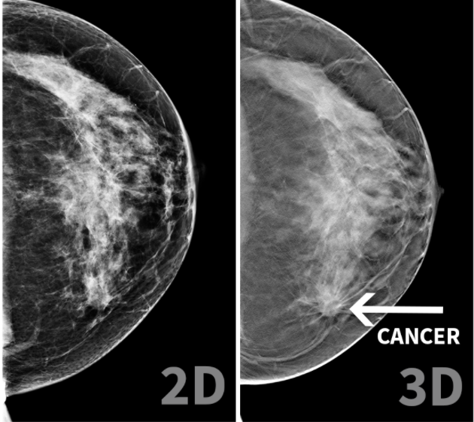
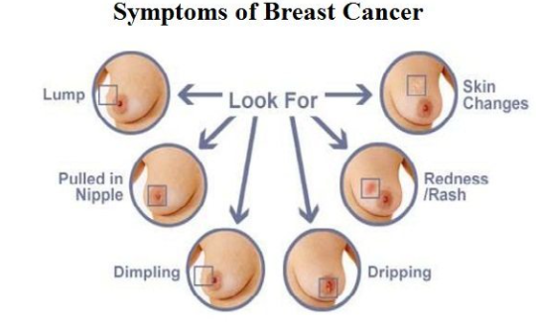
Pic Credits: A Cancerous Word Press Report
TRADITIONAL METHODS OF DETECTION SUCH AS MAMMOGRAPHY REQUIRE EXPERTS

Slide 4
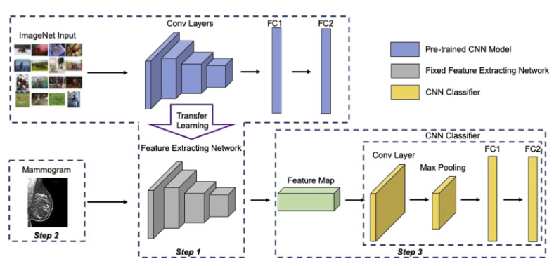
Pic Credits: Journal of American College of Radiology
DOMAIN TRANSFER LEARNING PROVIDES ABILITY FOR FAST, ACCURATE DETECTION REDUCING EXPERT RELIANCE

Slide 5
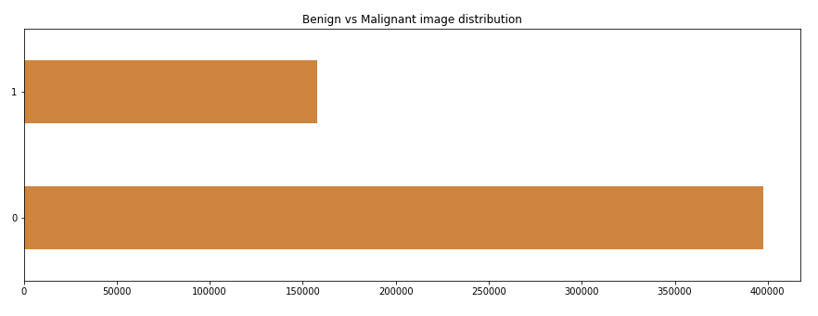
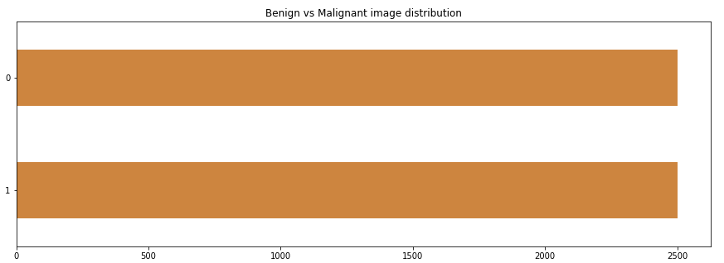
IMBALANCED INPUT
397476 BENIGN CANCER IMAGES
157572 MALIGNANT CANCER IMAGES
BALANCED FOR STUDY
2500 BENIGN CANCER IMAGES
2500 MALIGNANT CANCER IMAGES
Breast Cancer Histopathology Images, Case Western Reserve University
DATASET details

Slide 6
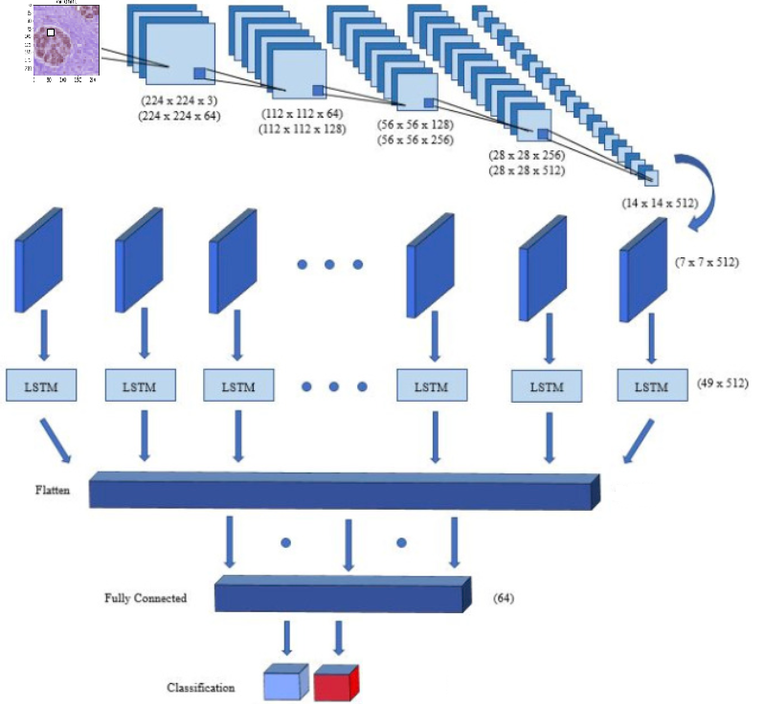
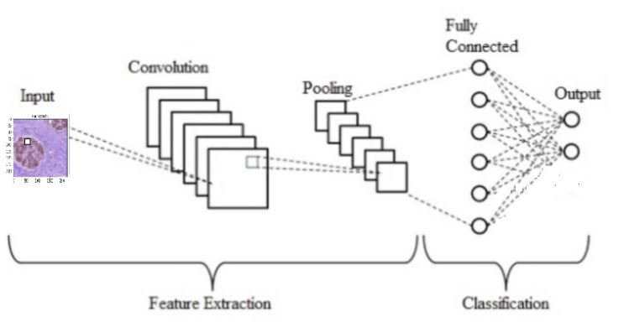
CNN + CUSTOM DNN LAYERS
CNN + LSTM
Pic Credits: Md. Zabirul Islam, Md. Milon Islam, Amanullah Asraf, Science Direct
Study methodology

Slide 7
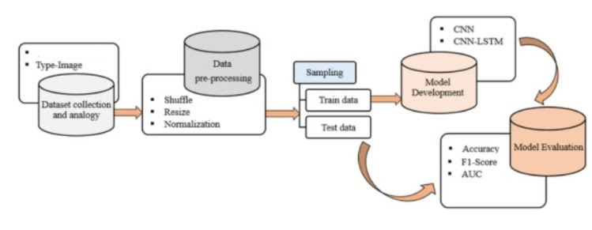
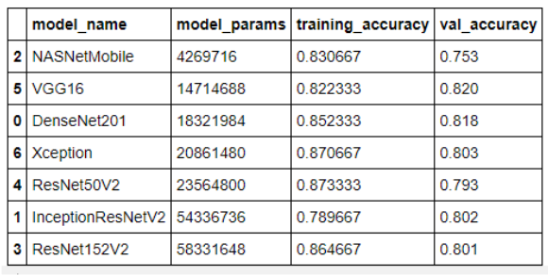
MACHINE LEARNING STAGES AND CNN MODELS

Slide 8
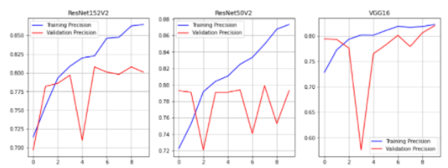
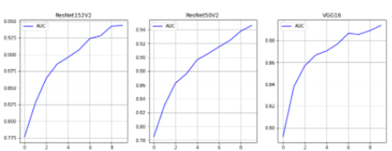
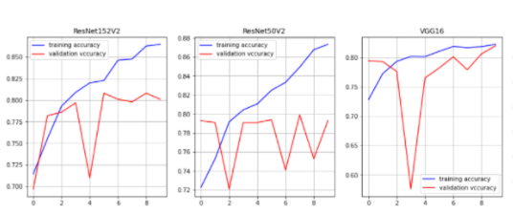
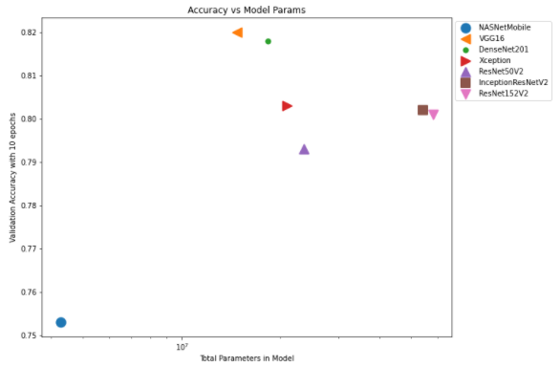
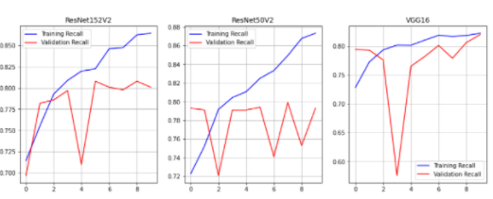
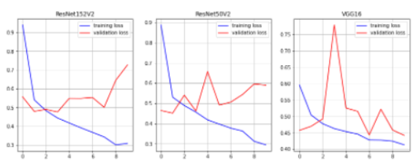
RECALL
AUC
PRECISION
SIZE VS ACCURACY
ACCURACY
MULLER LOOP EVALUATION
LOSS

Slide 9
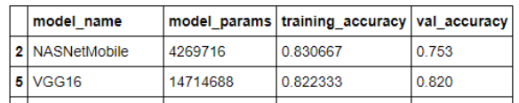
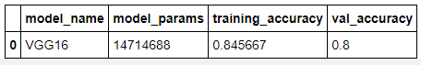
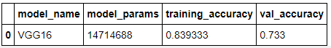
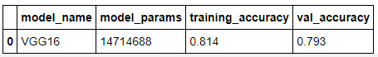
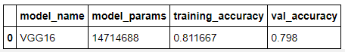
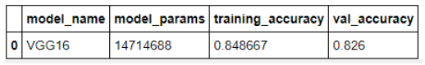
BASELINE
INCREASE EPOCHS
BATCH NORMALIZATION
AUGMENT IMAGES
DROPOUT 0.5
UNFREEZE 4 CNN LAYERS
HYPER PARAMETER TUNe VGG16

Slide 10
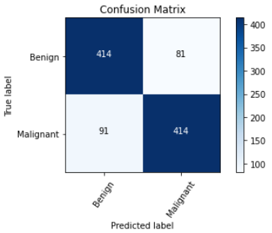
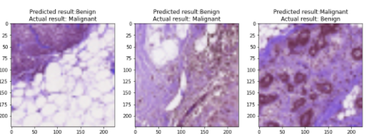
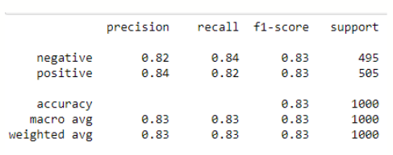
ACCURACY
CONFUSION MATRIX
SUPPORT
FEW COMMON ERRORS IN PREDICTION
BEST MODEL VGG16

Slide 11
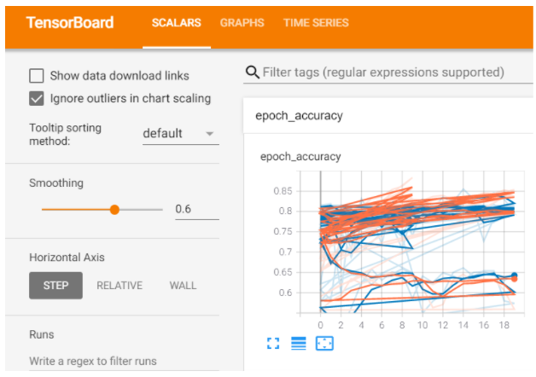
TENSORBOARD INTEGRATION
DEMO LINK

Slide 12

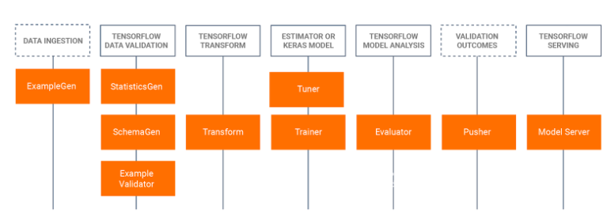
AUTOMATED PIPELINES WITH TFX

Slide 13
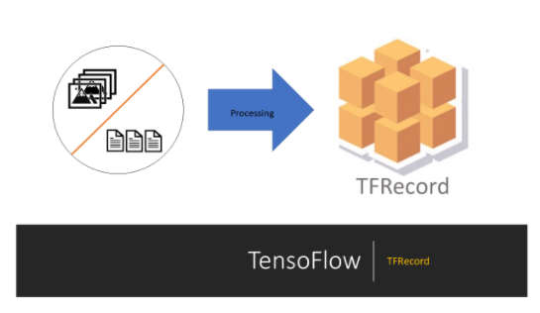
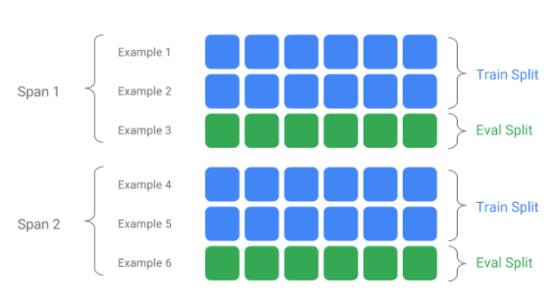
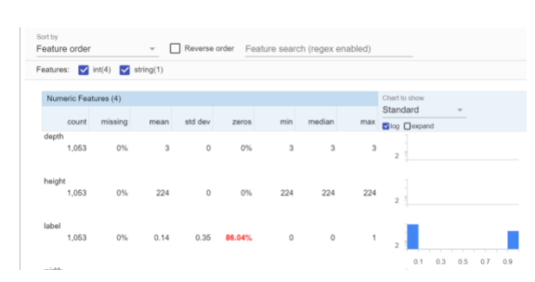
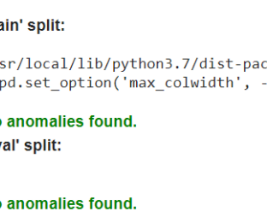
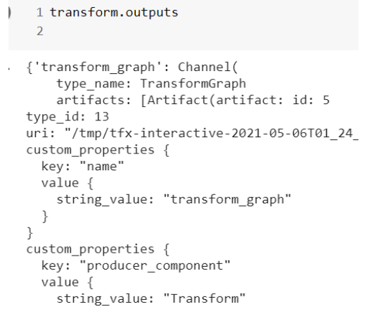
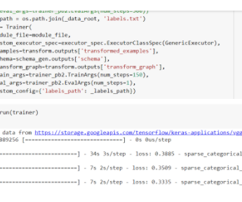
PRE-PROCESS
EXAMPLE GEN
STATISTICS GEN
EXAMPLES VALIDATOR
TRANSFORM
TRAINER

Slide 14
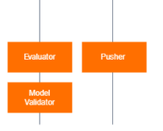

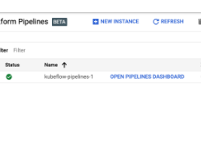
TFX EVALUATOR, PUSHER
CLOUD PLATFORM
DEPLOYED ON GCP AI PLATFORM

Slide 15
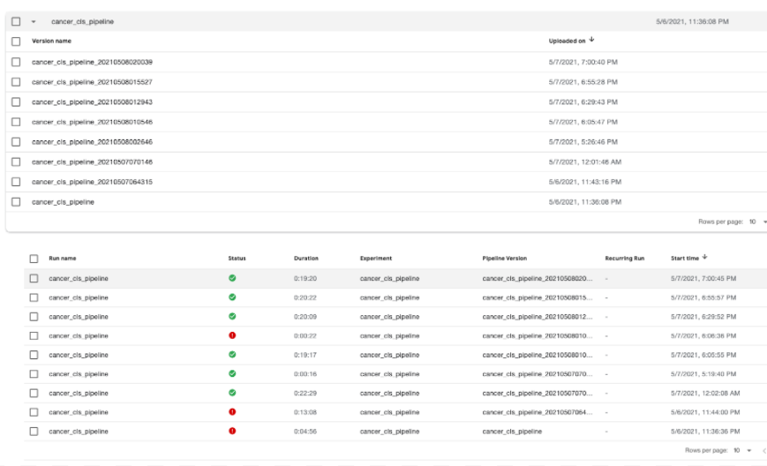
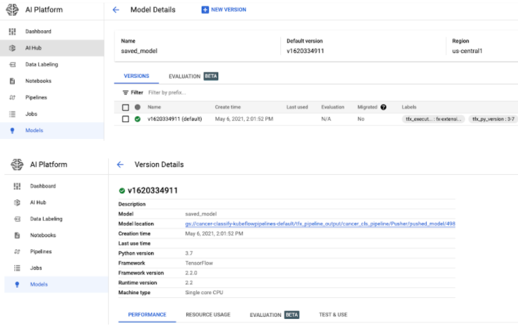
Running & deploying Kubeflow pipelines, versioning

Slide 16
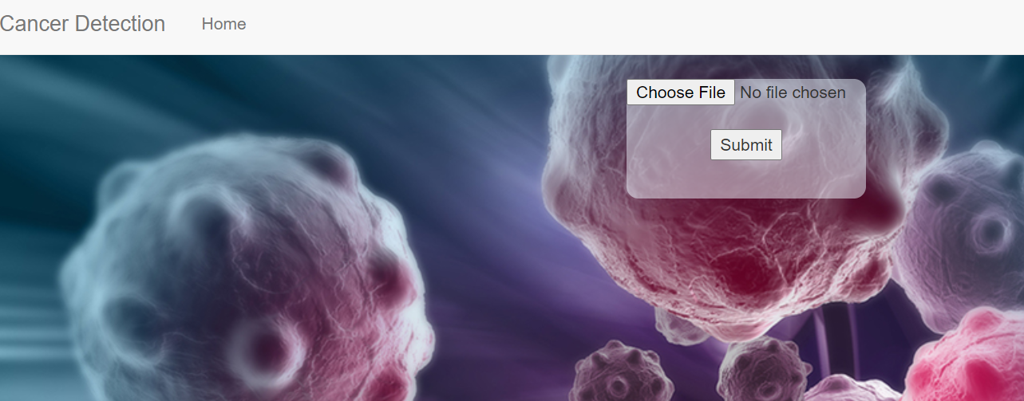
FLASK WEB APP HOSTED EC2
MAKES GOOGLEapi CALLS TO model (latest) deployed on GCP
DEMO LINK

Slide 17
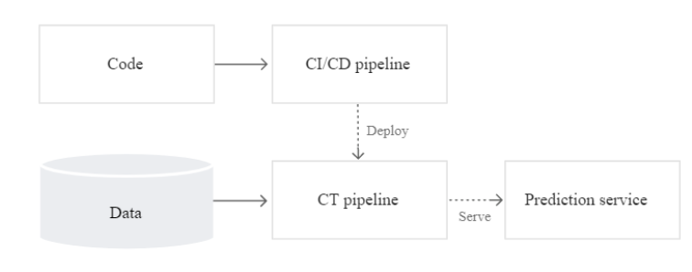
CI/CD PIPELINE VIA GITHUB, TFX, KUBEFLOWS
PIPELINE, MODEL VERSIONING VIA GOOGLE AI PLATFORM
REAL TIME PREDICTION VIA TENSORFLOW SERVING, GOOGLE API & FLASK WEB APP
HOSTED ON EC2
BIG PICTURE

Slide 18
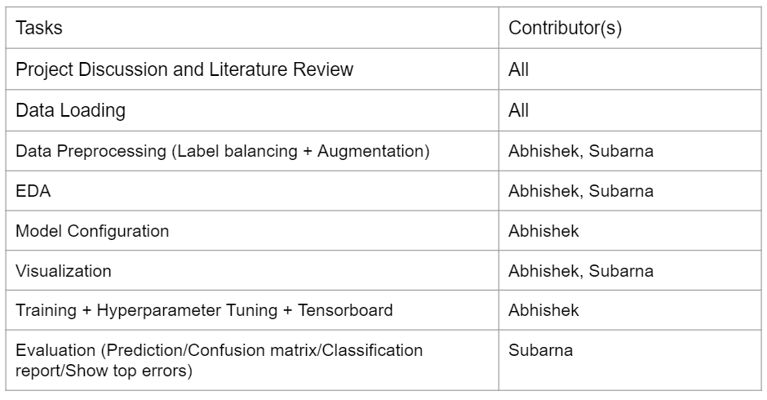
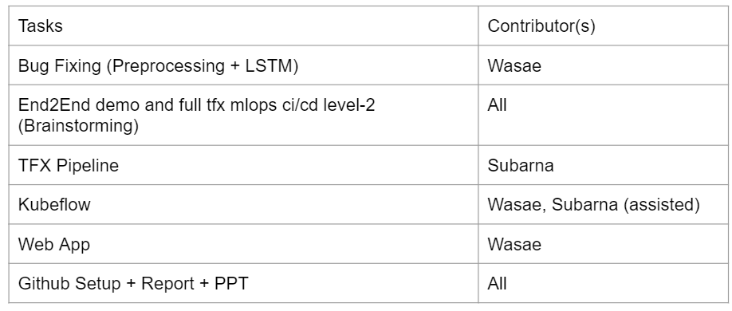
TEAM MEMBER CONTRIBUTIONS

Slide 19

DEEP TRANSFER LEARNING CAN PROVIDE EARLY, ACCURATE DETECTION

